Slide 1


A Comprehensive Scanning Tool for Web Servers
Alban Hysaj
University Metropolitan Tirana
FACULTY OF COMPUTER SCIENCE AND IT
COMPUTER ENGINEERING DEPARTMENT
TIRANA 2024

Slide 2
Problem statement
Problem statement
Lack of tools
Lack of knowledge
Lack of awareness
Outdated infrastructure
Scope
Day to day
School and work environments
Benefits
Awareness and training
Practical experience
Automation
Educational tool
Resource
Kali Linux
Nmap
Vulners

Slide 3



Objectives
Security Tools
Assisting IT Employees
Risk Evaluation

Slide 4

Proposed Solution
Provide an easy-to-use bash program designed to asses website security and discover vulnerabilities is the main goal
Automating
Modern technologies
Assessing vulnerabilities
Anywhere you go
Comprehensive and easy to use

Slide 5
Used technologies
Kali Linux – Used as the base environment where development takes place
Bash scripting – Automating scanning and reporting scripts
Nmap – Analyzing networks and servers
Vulners – Discover vulnerabilities
OpenSSL – Identifying certificate and scraping information
Curl – Automating, submitting and retrieving server information

Slide 6
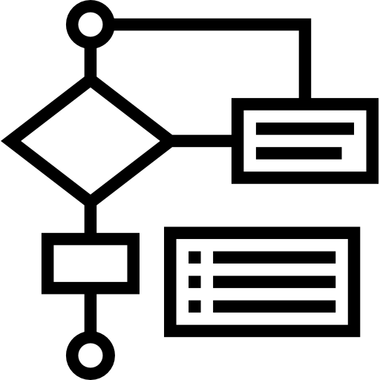
Program structure
Initialization
Certificate validation
TLS Protocol check
Vulnerability scan
Data retrieval
Result compilation
HTML report generation

Slide 7
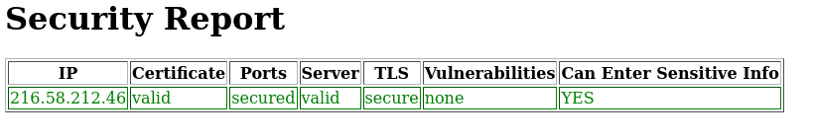
Program overview
Several powerful tools have been utilized in our program. Kali Linux provided a robust environment for development, openssl for TLS protocol checks, nmap with Vulners for vulnerability scans, and curl for data retrieval. Each tool plays a crucial role in our comprehensive security assessment.

Slide 8


Challenges
Technical challenges
Ethical challenges

Slide 9
Thank you for your attention!
Feel free to ask for anything, except my password…
Or run the command `--help`

